Slide 1
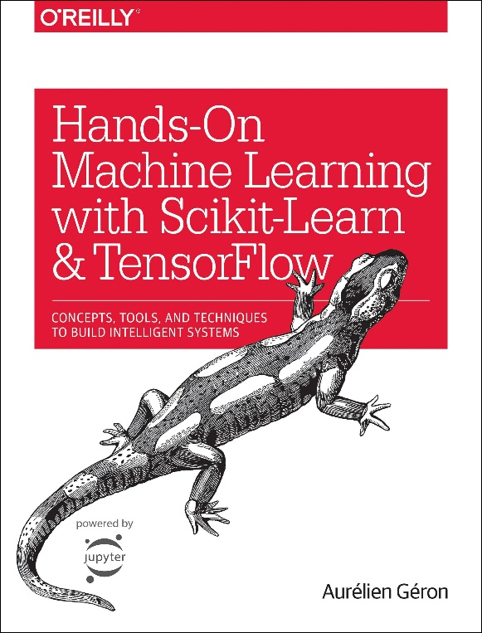

Novice Machine Learning E2E Project
Part 14
Pickling Models
Mukunthan Ragavan

Slide 2
E2E Machine Learning Project
Look at the Big picture.
Get the Data (Split the Data, Stratifying the Data).
Discover and visualize the data to get insights.
(Scatter with plot with density and color map, Correlation)
Prepare the data for ML algorithms. (Data Cleaning, One Hot Encoding, Custom Transformers, Pipelines)
Select a model to train it. (Linear Regression model, RMSE,
K-fold Cross validation, Pickling Models)
Fine-tune your model.
Present your solution.
Launch, monitor and maintain your system.

Slide 3
Coding in action !

Slide 4
Thanks All for watching and your subscription !

